Slide 1
IMA MARKET
PIP2001 Capstone Project
Review-0
Batch Number: IST-03
Under the Supervision of,
Prof. Srinivas Mishra
Associate Professor
School of Computer Science and Engineering
Presidency University
Roll Number | Student Name
20211IST0025 | Gana N H
20211IST0004 | Aneesh K
20211IST0015 | Azmath Patel
20211IST0018 | Rajavardhan R
Name of the Program: Information Science And Technology
Name of the HoD: Dr.Pallavi R
Name of the Program Project Coordinator: Prof. Srinivas Mishra
Name of the School Project Coordinators: Dr. Sampath A K

Slide 2
Content
Problem Statement
Analysis of Problem Statement
Timeline of the Project
References

Slide 3
Problem Statement Number:PSCS169
Organization: FIS SOLUTIONS(INDIA)
Category : Software
Problem Description: To harness India's IT talent for national projects, we propose two
interconnected platforms: the National Importance Project Portal, which lists crucial
projects with details for both financial and technical contributions, and the Skill-Based
Volunteer Network, which matches IT professionals with these projects based on their
skills and interests. The portal will facilitate project tracking, collaboration, and feedback,
while the network will enable resource sharing, training, and recognition for volunteers.
These platforms aim to provide rapid support for projects like the Ima Market recovery in
Manipur, leveraging IT skills to address national challenges efficiently.
Difficulty Level: Complex

Slide 4
Analysis of Problem Statement (contd...)
Proposal for Leveraging Indian IT Talent for National Importance Systems.
Proposal:
We propose developing two key platforms to mobilize India's IT talent:
1. National Importance Systems Platform (NISP):
Objective: Create an open web portal where critical national projects are listed. This platform will connect IT professionals, financial contributors, and project managers, enabling collaborative development and enhancement of systems that have national significance.
Benefits:
Rapid Response: By leveraging a pool of skilled professionals, projects can be developed and deployed quickly.
Community Engagement: Encourages a sense of ownership and involvement among IT professionals and financial contributors.

Slide 5
Analysis of Problem Statement (contd...)
2. ECommerce for Disaster-affected Markets (EDAM):
Objective: Develop a specialized eCommerce platform for markets like Ima Market to continue operations during disruptions. This platform will facilitate online sales and integrate with existing delivery systems like India Post.
Benefits:
Continuity of Commerce: Allows vendors to keep their business running even during physical disruptions.
Economic Stability: Supports local economies and ensures that vendors can continue to provide for their families.
Accessibility: Provides a platform for vendors with limited technical resources to manage their online presence.

Slide 6
Analysis of Problem Statement
Technology Stack Components:
Web Technology:
Frontend:
HTML/CSS/JavaScript: For building the user interface and ensuring responsiveness.
React/Vue.js/Angular: For dynamic and interactive UI components.
Backend:
Node.js/Express: For server-side logic and handling API requests.
Database:
MongoDB: For storing project details, user data, and contributions.
Hosting & Deployment:
AWS/Azure/Google Cloud: For scalable cloud hosting and deployment.
Documentation:
Github:https://github.com/Azmath-77/Ima-Market

Slide 7
Timeline of the Project
Project Planning | (Weeks 1-2)
Review 0 | 17th September,2024
Design Phase | 18th-30TH September, 2024
Development Phase | 1st-10th October, 2024
Review 1 | 12th-15th October,2024
Deployment Phase | (Weeks 16-17)
Review 2 | 25th-30th October,2024
E-Commerce website completion | 5th-10th November, 2024
Review 3 | 15th-20th November,2024
Post-Deployment | 22nd-25th November, 2024
Testing Phase | 1st-10th December, 2024
Review Final | 15th-20th December, 2024

Slide 8
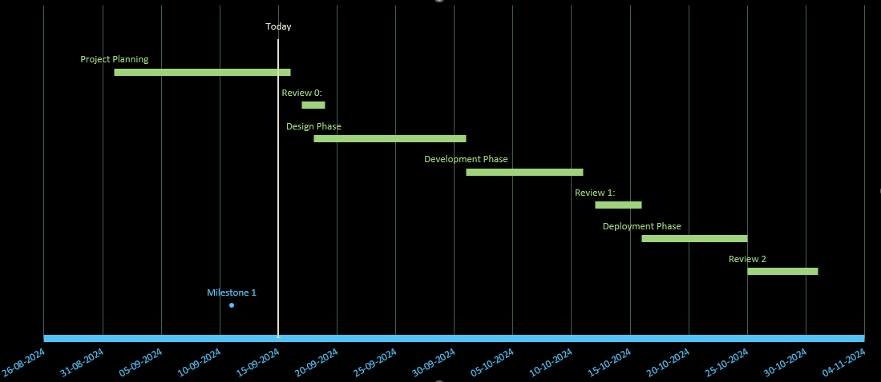
Timeline of the Project (Gantt Chart)

Slide 9
References (IEEE Paper format)
Kumar, G. S., & Jose, J. T. (2017). Developing an electronic commerce platform. 2017 IEEE International Conference on Power, Control, Signals and Instrumentation Engineering (ICPCSI). https://doi.org/10.1109/icpcsi.2017.8391922
X. Tian and W. Dai, "Study on Information Management and Security of E-commerce System," 2010 International Symposium on Intelligence Information Processing and Trusted Computing, Huanggang, China, 2010, pp. 270-273, doi: 10.1109/IPTC.2010.183.
M. Khoury and S. Shirmohammadi, "Accessibility and scalability in collaborative eCommerce environments," 2007 2nd International Conference on Digital Information Management, Lyon, France, 2007, pp. 738-743, doi: 10.1109/ICDIM.2007.4444312.
M. Lingyu, C. Lauren and D. Zhijie, "Strategic Development of Fresh E-Commerce With Respect to New Retail," 2019 IEEE 16th International Conference on Networking, Sensing and Control (ICNSC), Banff, AB, Canada, 2019, pp. 373-378, doi: 10.1109/ICNSC.2019.8743243.

Slide 10


